Slide 1
UTSA CS 4593: CS-CURE
Course-based Undergraduate Research Experience in CS
Amanda Fernandez, Ph.D
UTSA Department of Computer Science
Spring 2024

Slide 2
Week 7: Data Analysis

Slide 3
UTSA CS-CURE
Reminder about Mid Term Grades:
Mid semester grades are posted to ASAP for undergraduates.
You must contact your academic advisor if you are below a C-
Week 7
Objectives:
Identify the data & sources useful to a research initiative
Understand ethical considerations for research execution & analysis
Deliverables:
Activity 5: Data Analysis & Visualization (in-class on Thursday)
Research Outline - Canvas > Modules > Research Project - due next week!

Slide 4
Data Analysis
Fundamentals

Slide 5
Data Analysis vs Analytics
Data analytics = field of study using data and tools for business applications
Data analysis = specific actions/techniques used for data analytics
Goals:
Find trends
Predict actions, events, or triggers
Make decisions
Notes:
First, let’s start with some important terminology in the field.
Data analytics and data analysis actually refer to different things. [advance]
Data analytics refers to the broad field of study, where data and tools are used for applications in business, for example. [advance]
Data analysis is the term for these specific tools, actions, or techniques which are used. [advance]

Slide 6
Data Analysis
General components
Collection
Cleaning & preparation
Data analysis - initial (IDA) & exploratory (EDA)
Data transformations
Modeling & analysis

Slide 7
The Data Science Lifecycle
“Data science pipeline”
Acquisition of data
Preparation & maintenance
Preprocessing
Analysis
Communication
Notes:
Capturing raw data from relevant sources. This may be structured or unstructured, manually gathered or automatically acquired, acquired at once or over time.
Before we can analyze data, it needs to be formatted. This involves cleaning and loading the data into storage.
Different from preparation, we refer to a separate step of preprocessing the data, which involves taking a closer look for patterns and biases within the data.
Finally, data is ready for analysis, where a range of techniques can be applied to gain insights from the data.
Communication of insights through reports and visualizations is the final step, enabling discoveries to be applied to real-world problems.

Slide 8

Data Acquisition
Where do we get the data?
Consider the source(s)
Examples of data sources:
APIs
Web-scraping
Open source repositories
Data loggers or acquisition systems
UC Irvine
Machine Learning
Repository
https://new.nsf.gov/focus-areas/artificial-intelligence/nairr
Notes:
Data acquisition very generally refers to the process of gathering data for a task.
While this is always inherently task-specific, it is critical to [advance] consider the quality, integrity, and reliability of your source when gathering the data for analysis.
No data source will always be perfect, so the topic of uncertainty will be important no matter the source.
Some common examples of data sources include [advance]
application programming interfaces (or APIs), if you are a programmer and there is a source of data opened by a provider
Web-crawling or web-scraping approaches, wherein no API exists for a resource but you develop a set of scripts to mine the data from the Internet
Open source repositories, which are publicly available and free resources provided for communities to collaborate and improve
And finally, data loggers or more broadly the data acquisition systems for physical measurements

Slide 9
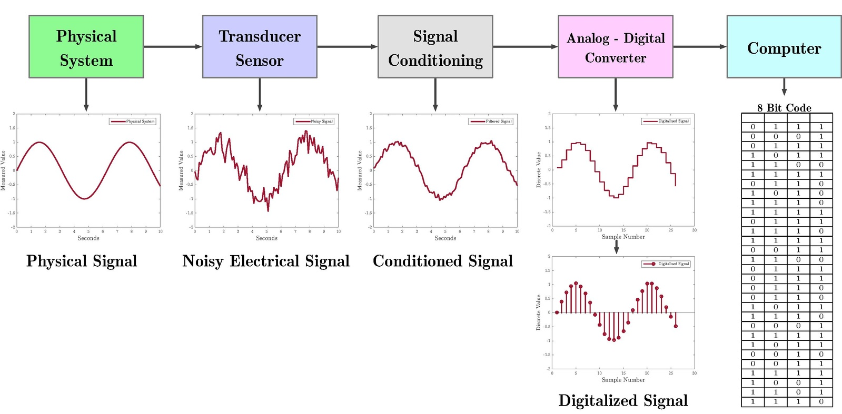
Data Acquisition
Data acquisition systems (DAS, DAQ, DAU)
Image source: Wikipedia
Notes:
If you’re working on data from a physical phenomenon, then data acquisition is centered around the physical properties you aim to measure.
This may include for example temperature, humidity, fluid flow, gas pressures, vibrations, and so on.
In this case, the goal is to sample signals measured and convert the samples into digital values (numeric values) which are more useful to our data science techniques.
We refer to these analog to digital data acquisition systems by any of the acronyms “DAS”, “DAQ”, or “DAU” - an example diagram of components is shown on the right.
Sensors in the system convert physical parameters to electrical signals.
Signals are then conditioned, to be in a form for digital conversion, and processed by the computer.

Slide 10
Data Preparation
Cleaning
Better data is preferable to any “fancy” method/algorithm.
Question any outliers in your data.
Label: “bear”
Notes:
(Read bullet 1)
There is an expression (advance slide): “garbage in, garbage out”!
Your best algorithm will only be as good as the data it is given.
If we can put quality data into our project, then we can expect good results using data science approaches.
This is especially true if we extend our data for use in machine learning applications, which rely on the data to infer qualities about any new data that becomes available.
(Advance slide)
Relating to data quality, you should question any outliers in your data.
These are samples which lie far beyond the typical range for a class.
Suppose I am gathering data where each sample is an animal. (Advance slide)
It is critical to examine data within each category to ensure that you are aware of any inconsistencies in the definition of that data range.
In this example, suppose we examine the “bear” data from the dataset. (Advance slide)
Taking a look at only the bear data (advance through), we may find data which is technically labeled correctly but which is definitely an outlier in comparison with the other data and which may not be relevant to the problem we are trying to solve.

Slide 11
Data Preparation
Cleaning
Reduce any structural problems in your data.
In text, fix typographical errors, capitalization, & any inconsistencies.
In images, you may decide to use one orientation (i.e. portrait, or landscape), or one image file type (i.e. JPEG)
It is important to reduce duplicates and any irrelevant information.
Duplicate records/samples are typical when combining data from different sources.
Data is “irrelevant” if it doesn’t fit the specific problem you’re trying to solve!
Notes:
Data acquisition very generally refers to the process of gathering data for a task.
While this is always inherently task-specific, it is critical to [advance] consider the quality, integrity, and reliability of your source when gathering the data for analysis.
No data source will always be perfect, so the topic of uncertainty will be important no matter the source.
Some common examples of data sources include [advance]
application programming interfaces (or APIs), if you are a programmer and there is a source of data opened by a provider
Web-crawling or web-scraping approaches, wherein no API exists for a resource but you develop a set of scripts to mine the data from the Internet
Open source repositories, which are publicly available and free resources provided for communities to collaborate and improve
And finally, data loggers or more broadly the data acquisition systems for physical measurements

Slide 12
Data Analysis
Error & Confidence

Slide 13
Error & Confidence
In data analytics
Data in the “real world” can be uncertain
Uncertainty is the estimation of error present in our data
Precision and accuracy identify error
Mean and standard deviation describe confidence

Slide 14
Error
In data analytics
Let T be a statistic used to estimate parameter X and let E(T) denote expected value of T
Systematic error
Also referred to as bias, or statistical bias
Random error
Also random variation
bias(T,X) = bias(T)
bias(T) = E(T) - X
If bias(T,X) = 0, then T is unbiased
Notes:
Error in data analysis can take on many forms. [advance]
We refer to systematic error also as a term of bias or statistical bias, these are tendencies in the system to cause differences between facts and our results.
In comparison, [advance] random error or random variation, refers to the variation between observations due to factors that are not within control.
Random errors for example occur in multiple observations taken from a failing or overloaded piece of equipment.
For an example of systematic errors, we can look at the bias of a statistic [advance].
Let’s let T be a statistic used to estimate a parameter X, and E of T will denote the expected value of T.
In this case, [advance], the bias of T,X is assumed to be the bias of T,
And the bias of T is equal to the expected value of T, minus X.
If the value of “bias of T,X” is zero, we know that T (our statistic) is an unbiased estimator for our parameters such as X.

Slide 15
Error & Confidence
Precision vs. Accuracy
Accurate
Precise
Accurate
Precise
Accurate
Precise
Accurate
Precise
Notes:
In testing and validation, accuracy refers to the measure of how close a predicted result is to the known true value.
Precision refers to the consistency of these predictions in relation over multiple tests.
Let’s imagine a target used for target practice. [advance]
The goal is to hit the center of the target only. We regard these examples as both accurate and precise as they are neatly grouped in the center of the target, the goal.
Were they spread out slightly [advance] like these, we would still regard the examples as fairly accurate (they lose a little accuracy when they are no longer in the center circle), however they are not precise, as they are not grouped together.
Likewise, [advance] we can have examples clustered nicely as in this case - this is precise, but not accurate, as our goal is to get them at the center of the target.
[advance]
Finally, we can see this last set of examples is neither accurate (at the center of the target) nor precise.

Slide 16
Error & Confidence
Uncertainty in data
Confidence intervals provide a range of estimates for an unknown parameter
Mean
Standard Deviation
x1+x2+…+xn
N
Mean
Standard deviation
-2
-1
0
1
2
Notes:
Uncertainty is reported in terms of confidence.
Confidence intervals provide a range of estimates for an unknown parameter.
Mean values reflect an average of the observations or samples, over the number of samples/observations taken.
The standard deviation measures the spread of the data, giving more of an indication how far a sample is spread from the mean.

Slide 17
Data Visualization
Techniques

Slide 18
Data Visualization
Techniques & considerations
Clarity & accuracy
Ensure data representation is truthful & readily interpretable
Choose the right chart
Different chart types (bar charts, line graphs, scatter plots, pie charts, etc.) are suitable for different data types & research questions
Aesthetics & design
Importance of color, labels, & layout - avoid clutter!

Slide 19
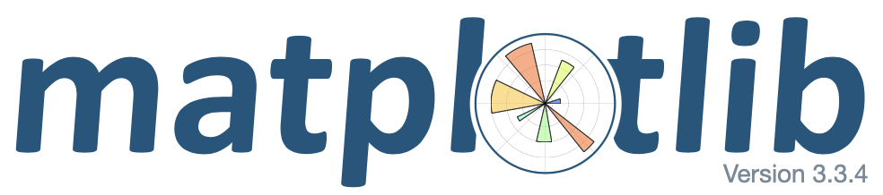
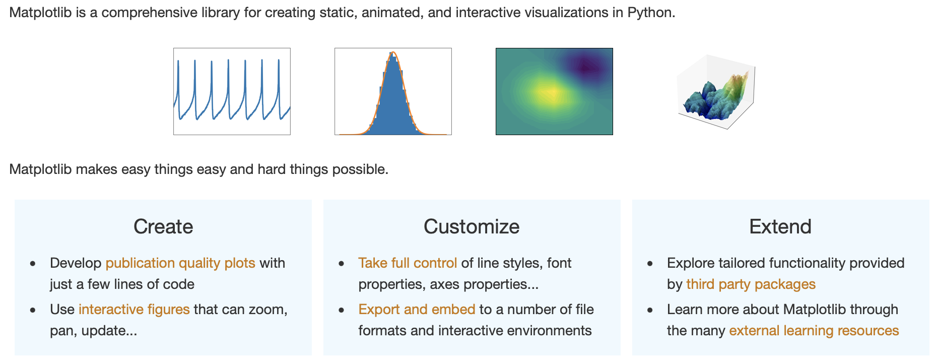
Matplotlib
Python for data science
https://matplotlib.org

Slide 20

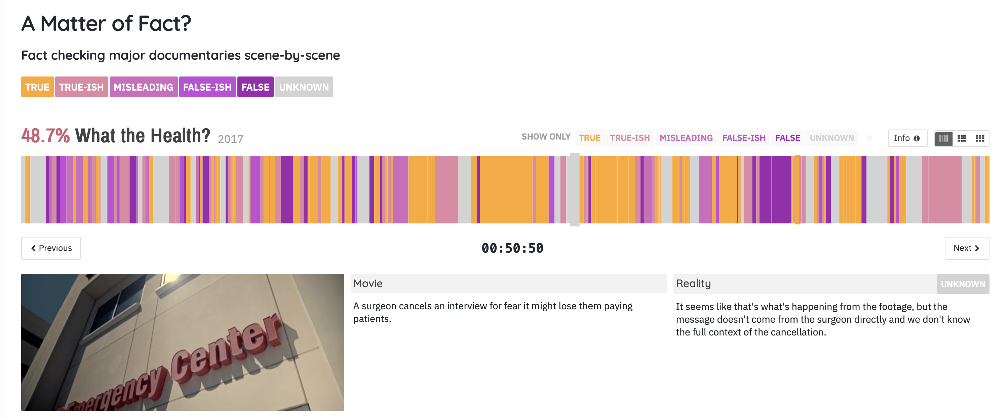
Suppose you’re interested in fact-checking a movie.
How would you present that data?
https://informationisbeautiful.net/visualizations/what-the-health-netflix-documentary-fact-checked-debunked/
More movies!

Slide 21
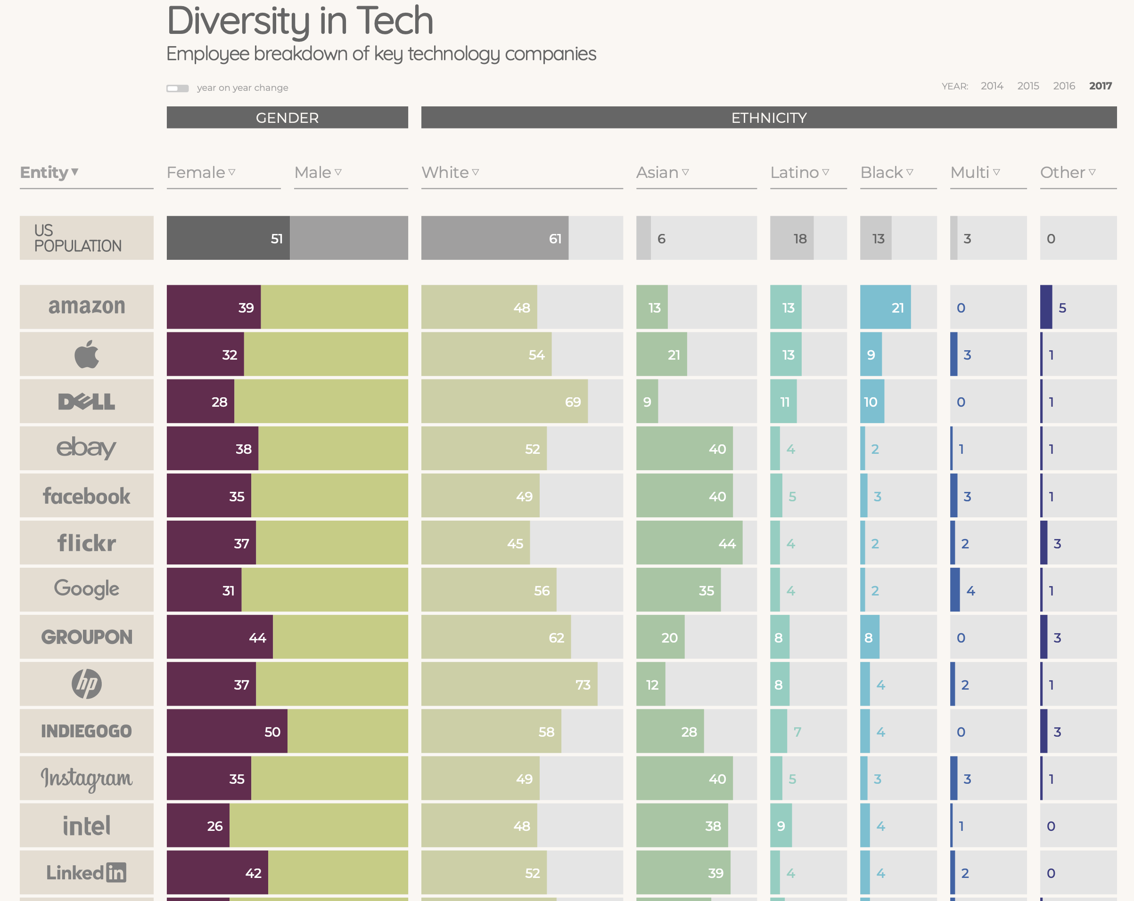

Slide 22
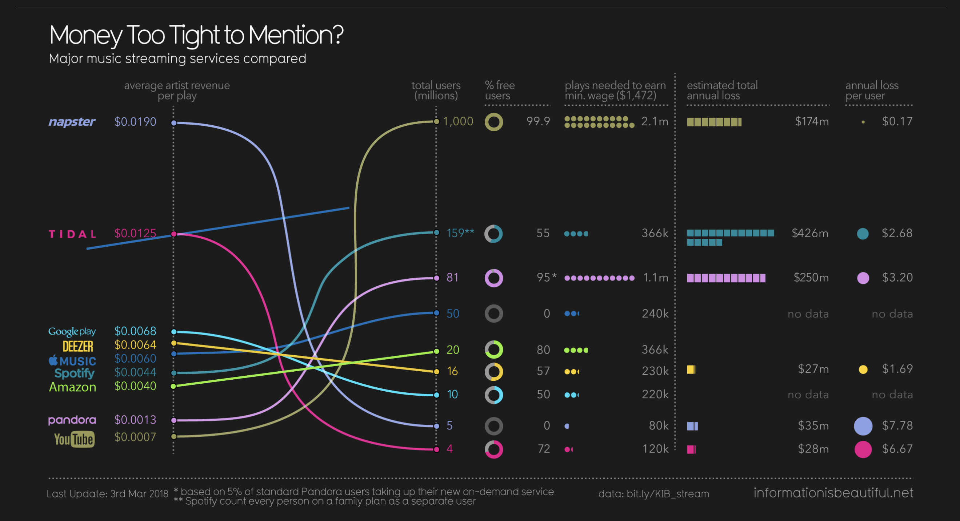
https://informationisbeautiful.net/visualizations/spotify-apple-music-tidal-music-streaming-services-royalty-rates-compared/

Slide 23
Data Visualization
Live examples!
# of undergraduates engaged in CS research at UTSA

Slide 24
Data Visualization
Live examples!

Slide 25
Data Analysis
Ethics

Slide 26
Ethics & Considerations
Data analysis
Ethical considerations protect both research participants and the integrity of research findings.
Consider, for example:
Privacy: protecting the anonymity & confidentiality of participants' data
Accuracy: data is complete & free from errors/biases
Transparency: about data collection, analysis methods, & limitations

Slide 27
Ethics & Considerations
Data in research
Consent: Ensure data collection complies with informed consent procedures.
Data anonymization: If possible, anonymize data before analysis to minimize risks.
Data security: Implement secure storage and access protocols to protect data privacy.
Bias awareness: Be aware of potential biases in data collection and analysis methods, and strive to mitigate them.
Honest reporting: Report results truthfully and accurately, acknowledging limitations and uncertainties.

Slide 28
Data Analysis - IRB
Internal Review Board approval
Even with the best intentions, research can pose risks to participants.
IRBs help ensure that:
potential risks are minimized
benefits are maximized
individuals participate voluntarily with informed consent.

Slide 29
Data Analysis - IRB
Internal Review Board approval
“The UTSA IRB is the standing committee that reviews & approves human subjects research for the purpose of protecting the rights and welfare of participants.”
Independent committee of experts
Meet regularly to review applications
Approve or deny based on established criteria
https://research.utsa.edu/compliance/irb.html

Slide 30
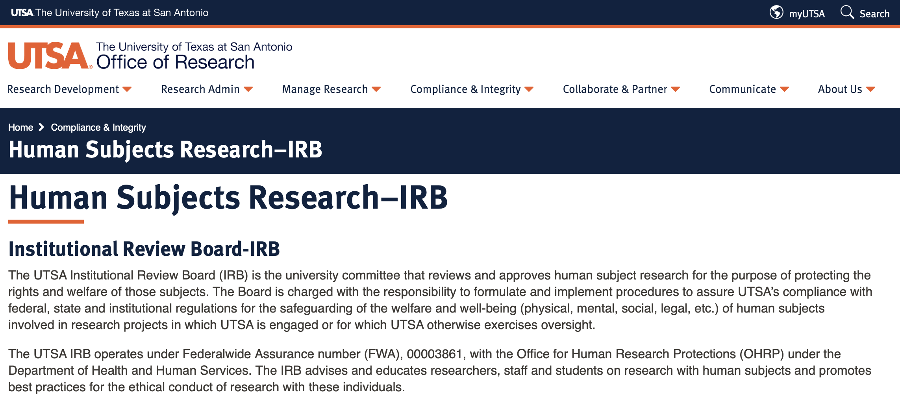
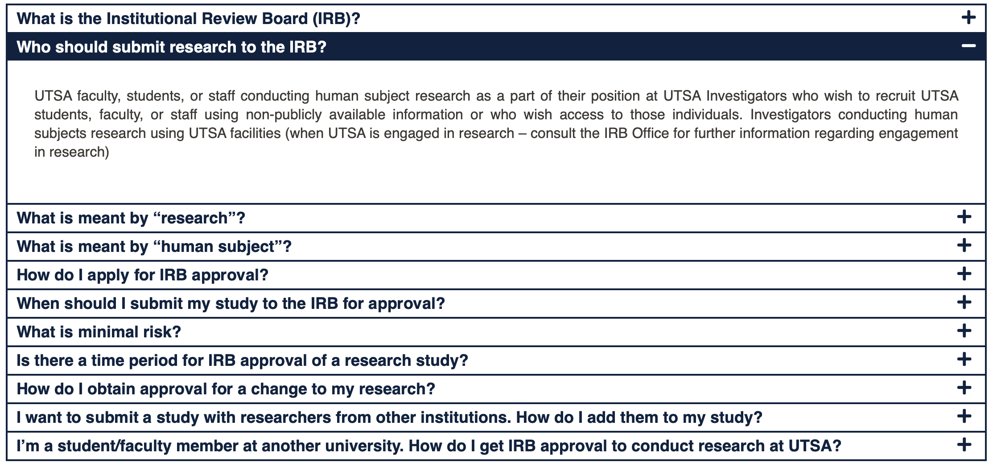
https://research.utsa.edu/compliance/irb.html

Slide 31
Key Elements of an IRB Review
Data ethics & considerations
Does the research have a valid scientific purpose?
Are the risks to participants reasonable compared to potential benefits?
Is there a clear informed consent process for participants?
Are participants' data protected and kept confidential?
Will vulnerable populations (children, prisoners, etc.) be adequately protected if involved in the research?

Slide 32
How do I do work with an IRB?
Data ethics & considerations
Develop your research protocol (clear description of your methods & procedures).
Complete any required IRB training.
Submit your protocol for review by the IRB.
Address any questions or revisions requested by the IRB.
Receive IRB approval before starting your research.

Slide 33
Wrap-Up
Tuesday
Identify the data & sources useful to a research initiative
Understand ethical considerations for research execution & analysis
To Do:
Activity 5: Data Analysis & Visualization (in-class on Thursday)
See you Thursday!

Slide 34
Research Project:
Research Outline

Slide 35


UTSA CS-CURE
Research Project
Research Proposal [week 3] - identifying a research problem
Research Outline [week 8] - organizing your research
Research Draft [week 12] - telling a good story
Research Paper [week 16] - depth of research in a field

Slide 36
Activity 5:
Data Analysis & Visualization

Slide 37
Wrap-Up
Thursday
Identify the data & sources useful to a research initiative
Understand ethical considerations for research execution & analysis
To Do:
Activity 5: Data Analysis & Visualization (in-class on Thursday)
See you next week!

